Slide 1


The Profitable Car Showroom
Data-Driven Insights for Mahindra Showroom Success
MINI PROJECT ANALYSIS
//
NOV 2025

Slide 2
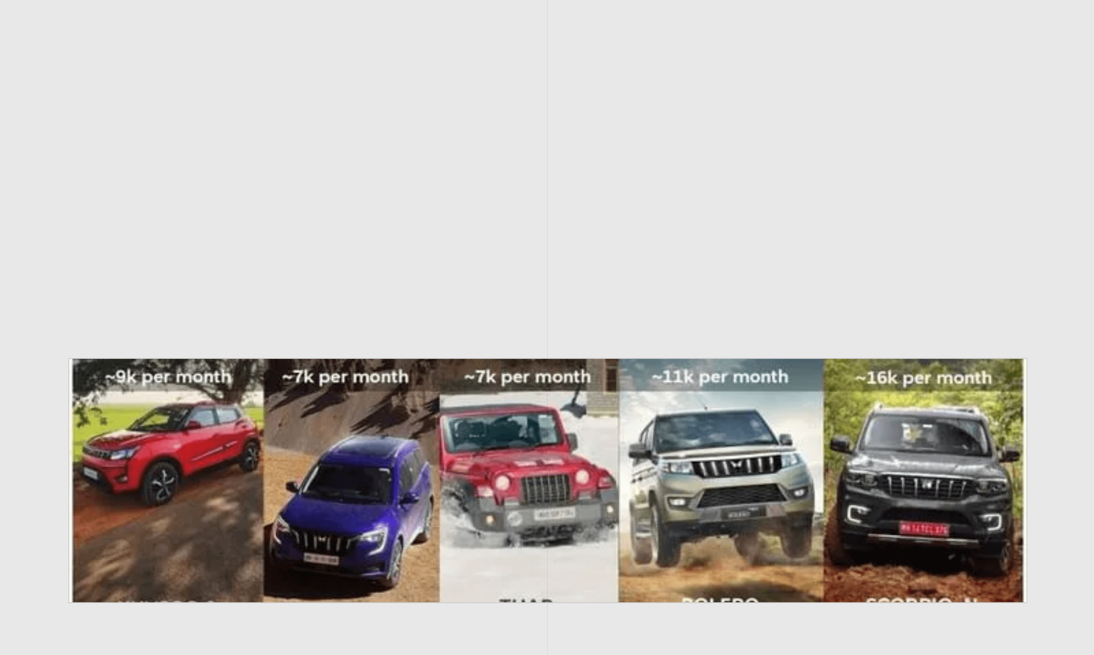
The Business Challenge
Understanding Which Models Drive Maximum Profit
The Critical Question
The Strategic Goal
The showroom manager faces a pivotal dilemma: Which car models are truly profitable, and which ones need strategic intervention? Sales volume alone is misleading. Success depends on total profitability, not just the number of units moved.
We must analyze five key models—Bolero, Scorpio, Thar, XUV700, and XUV300. The objective is to shift from intuition-based decisions to data-driven strategies that maximize revenue and optimize marketing resource allocation.

Slide 3

The Dataset Overview
Model
Units Sold
Profit per Car
(Per Month)
(INR ₹)
Five Mahindra Models Under Analysis
Bolero
25
1,50,000
Scorpio
40
1,90,000
The analysis examines monthly performance data across three key metrics for each model. This dataset captures both sales volume and unit profitability, providing the foundation for calculating total monthly profit contribution.
Thar
30
2,20,000
XUV700
45
2,50,000
XUV300
50
1,30,000

Slide 4

Calculating Monthly Profit
The Formula That Reveals True Performance
Monthly Profit
=
Units Sold
×
Profit per Car
This calculation transforms raw sales data into actionable business intelligence. While units sold shows customer demand and profit per car indicates margin efficiency, only monthly profit reveals the total financial contribution.
This metric enables direct comparison across all models regardless of their individual pricing or volume characteristics, allowing the manager to see which models are truly carrying the business.

Slide 5

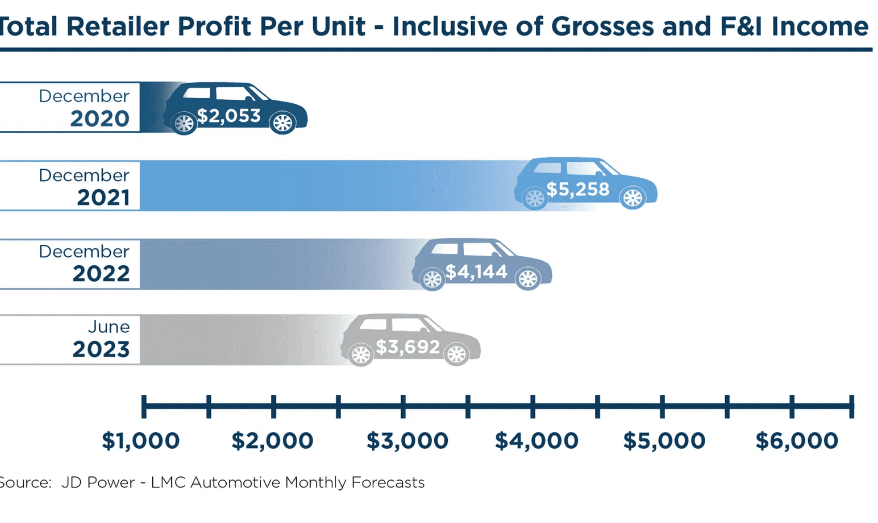
Complete Profitability Analysis
Monthly Profit Rankings Reveal Clear Winners
Model
Units Sold
Profit/Car (₹)
Monthly Profit (₹)
Total Monthly Profit
Bolero
25
1,50,000
37,50,000
₹3,56,50,000
Scorpio
40
1,90,000
76,00,000
Thar
30
2,20,000
66,00,000
XUV700
45
2,50,000
1,12,50,000
XUV300
50
1,30,000
65,00,000

Slide 6

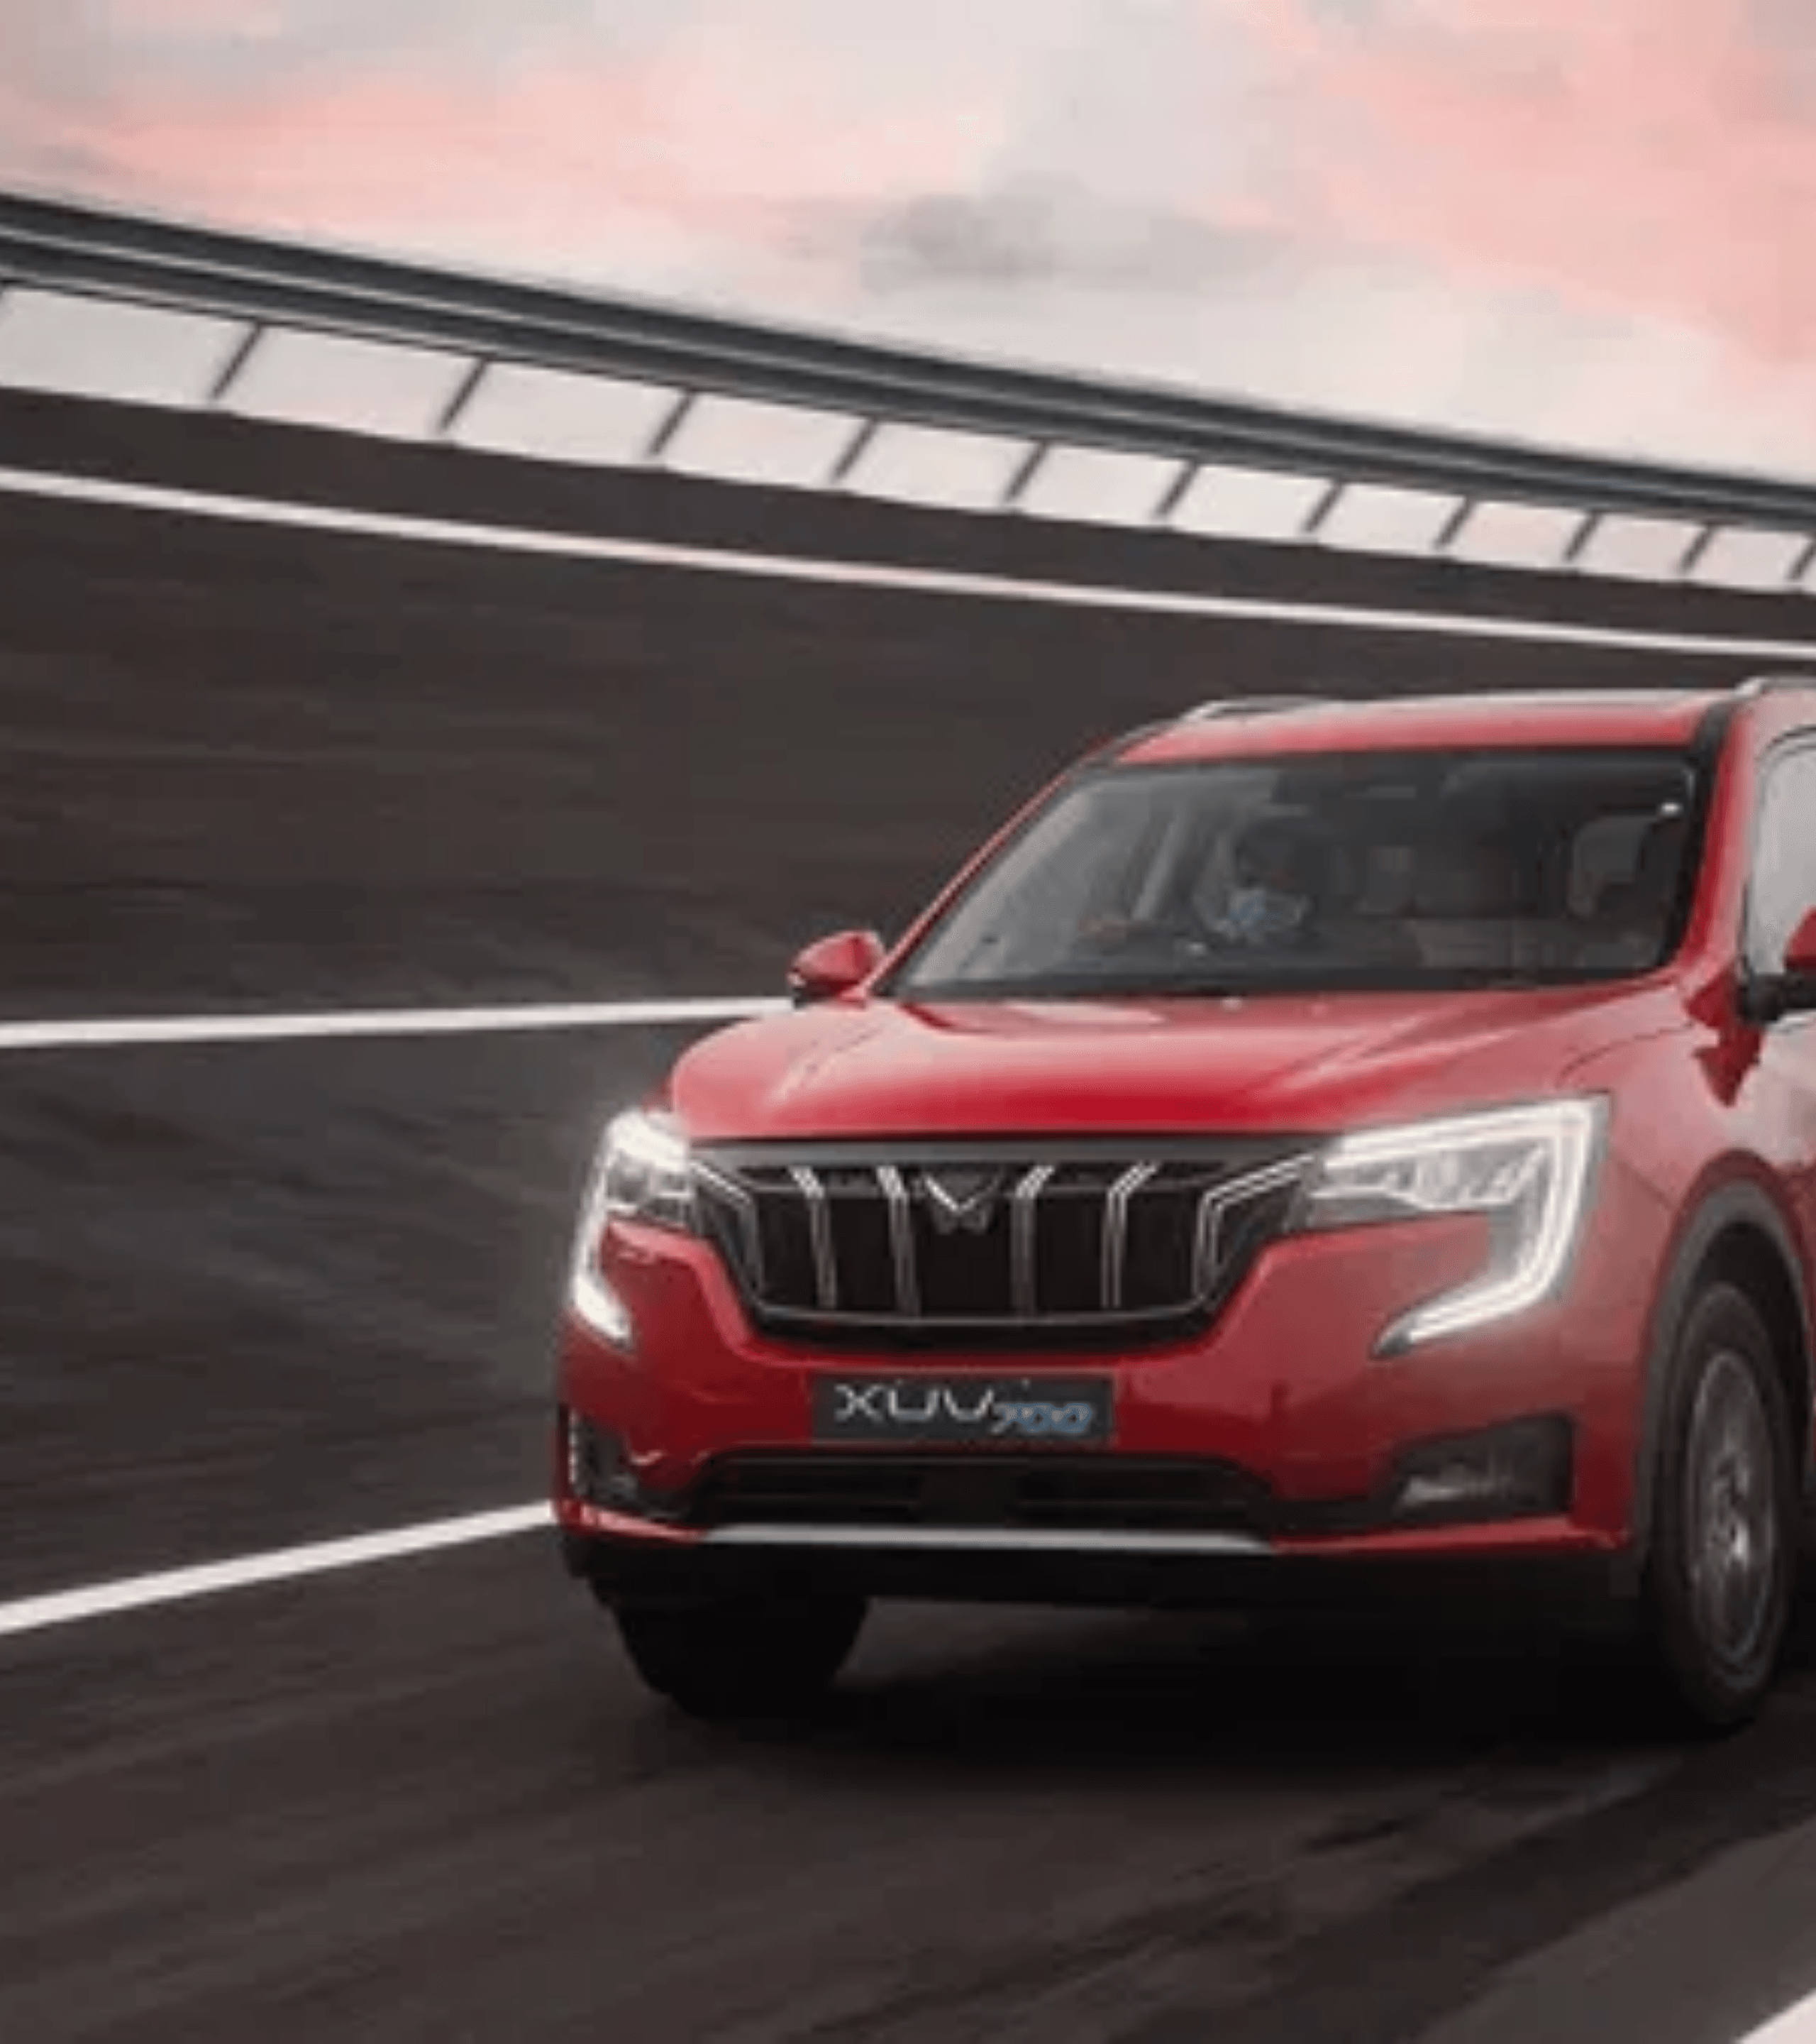
Key Insight #1
XUV700 Dominance
Monthly Profit Generated
₹1,12,50,000
Units Sold
Profit Per Car
Share of Total
45
₹2,50,000
31.5%
The XUV700 is the clear profit leader. Despite selling fewer units than the XUV300, its high margin strategy generates nearly double the profit of the volume leader. This model proves that high-value products can drive disproportionate business success.

Slide 7

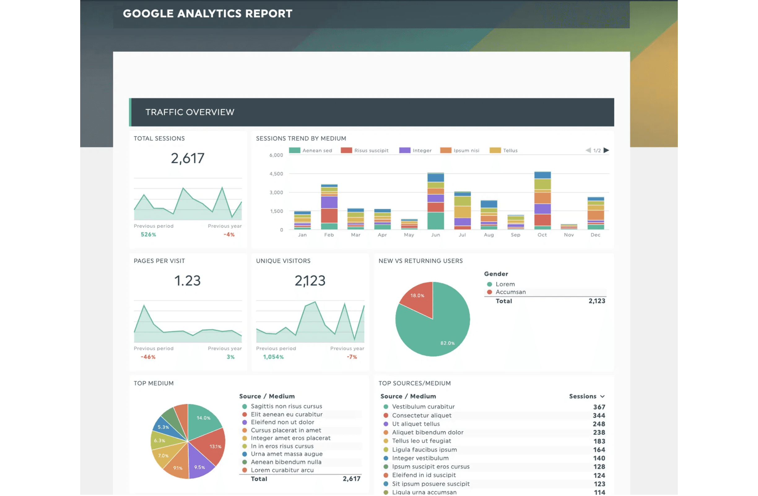
Key Insight #02
High Volume ≠ High Profit
XUV300 sells the most units (50 per month), yet it ranks fourth in total profitability. This illustrates a classic business paradox where volume leadership does not guarantee financial success.
50 Units
Sales Volume (Rank #1)
₹65 Lakhs
Total Profit (Rank #4)
The lower profit per car (₹1.3L) dilutes the impact of high sales volume, suggesting a need for pricing optimization or cost management.
Figure: Comparative Analysis of Retail Gross Profit Metrics

Slide 8

Key Insight #3
Bolero Requires Urgent Marketing Intervention
Lowest Profit
₹37.5 L
With the lowest profit contribution among all models, Bolero risks becoming a resource drain rather than a value driver. The current performance signals a disconnect with market demand or positioning.
Monthly Contribution
10.5%
Share of Total Profit
Strategic Imperative
Immediate action is required: enhanced marketing campaigns, promotional offers, or a reassessment of customer targeting to prevent further stagnation.
25
Units Sold

Slide 9

Strategic Recommendations
Data-Driven Actions for Showroom Success
High Performers
Volume Leaders
Underperformers
XUV700 & Scorpio
XUV300
Bolero
→
Increase inventory allocation and display prominence to prevent stockouts.
→
Explore pricing optimization or value-added packages to improve unit profitability.
→
Launch targeted marketing campaigns highlighting unique value propositions.
→
Develop premium customer experiences and exclusive test drive events.
→
Leverage high foot traffic generated by this model to cross-sell higher-margin vehicles.
→
Introduce limited-time offers or financing incentives to boost demand.
→
Train sales teams to upsell features and maximize conversion rates on these high-margin units.
→
Analyze cost structure to identify margin improvement opportunities without hurting volume.
→
Reassess market positioning and customer segment alignment to ensure relevance.

Slide 10

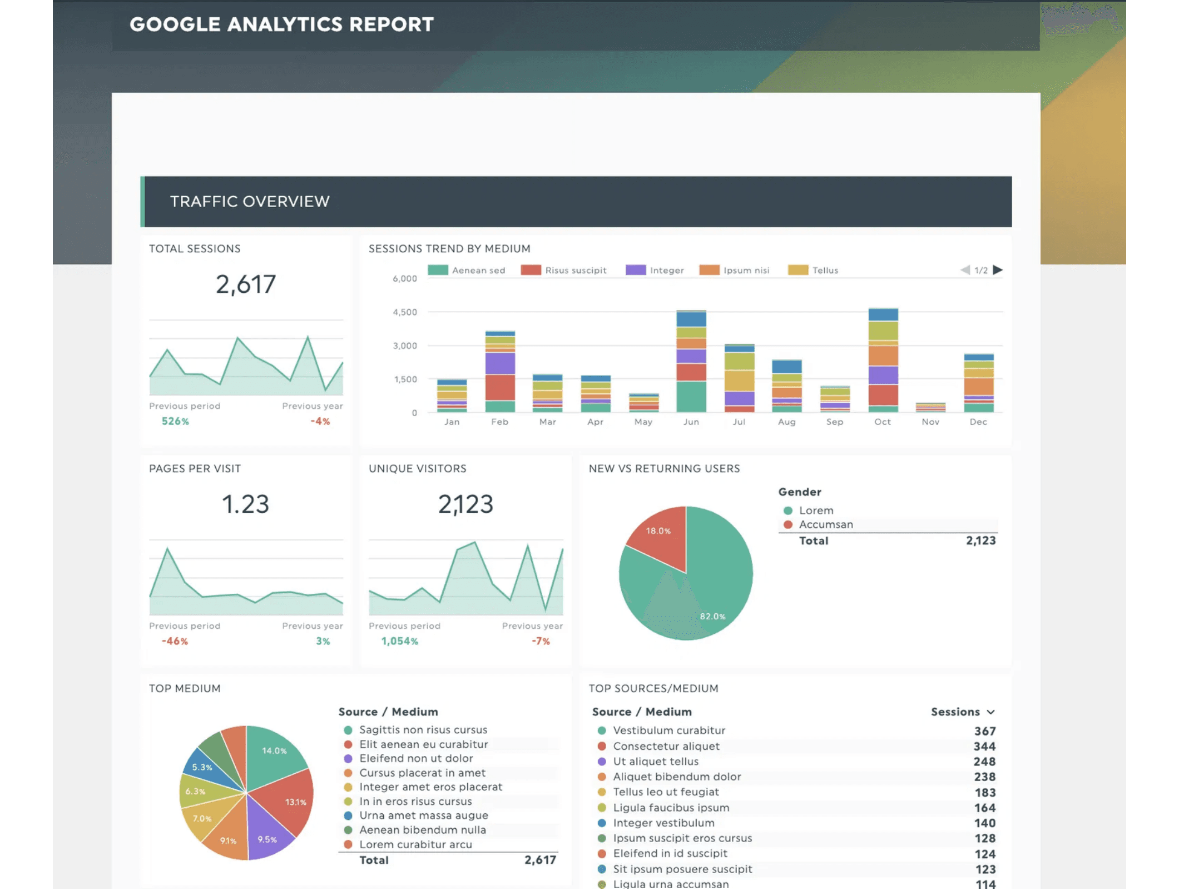
The Power of Data Analytics
From Guessing to Knowing: How Data Drives Decisions
"Data analytics is not about guessing. It is about using data to help the business take decisions."
A data analyst's role is to extract actionable intelligence from numbers—telling the business which product brings money and which product needs help.
This Mahindra showroom case is just the beginning. Real-world analytics scales to handle vastly larger and more complex datasets.
Future Tools to Master
Excel
•
SQL
•
Python
•
AI

Slide 11

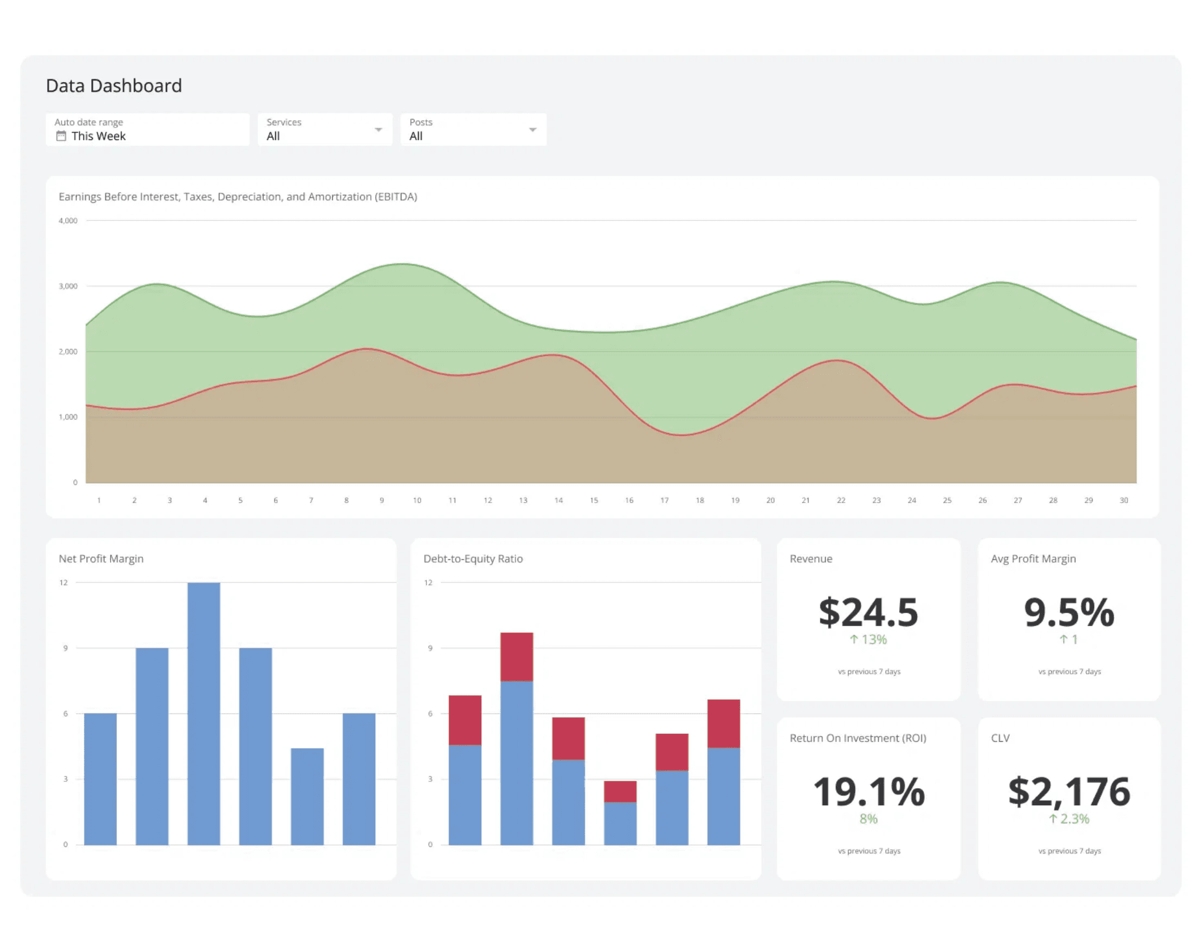
What You've Learned
Building Your Data Analytics Foundation
01
Data Collection
Gathering relevant business metrics like units sold and profit per car.
02
Data Processing
Calculating derived metrics (monthly profit) using formulas to reveal new information.
03
Data Analysis
Comparing performance across products to identify patterns and outliers.
04
Insight Generation
Translating raw numbers into actionable business recommendations.
05
Strategic Communication
Presenting findings clearly to drive decision-making.
The goal: Creating clear dashboards that inform strategy.

Slide 12

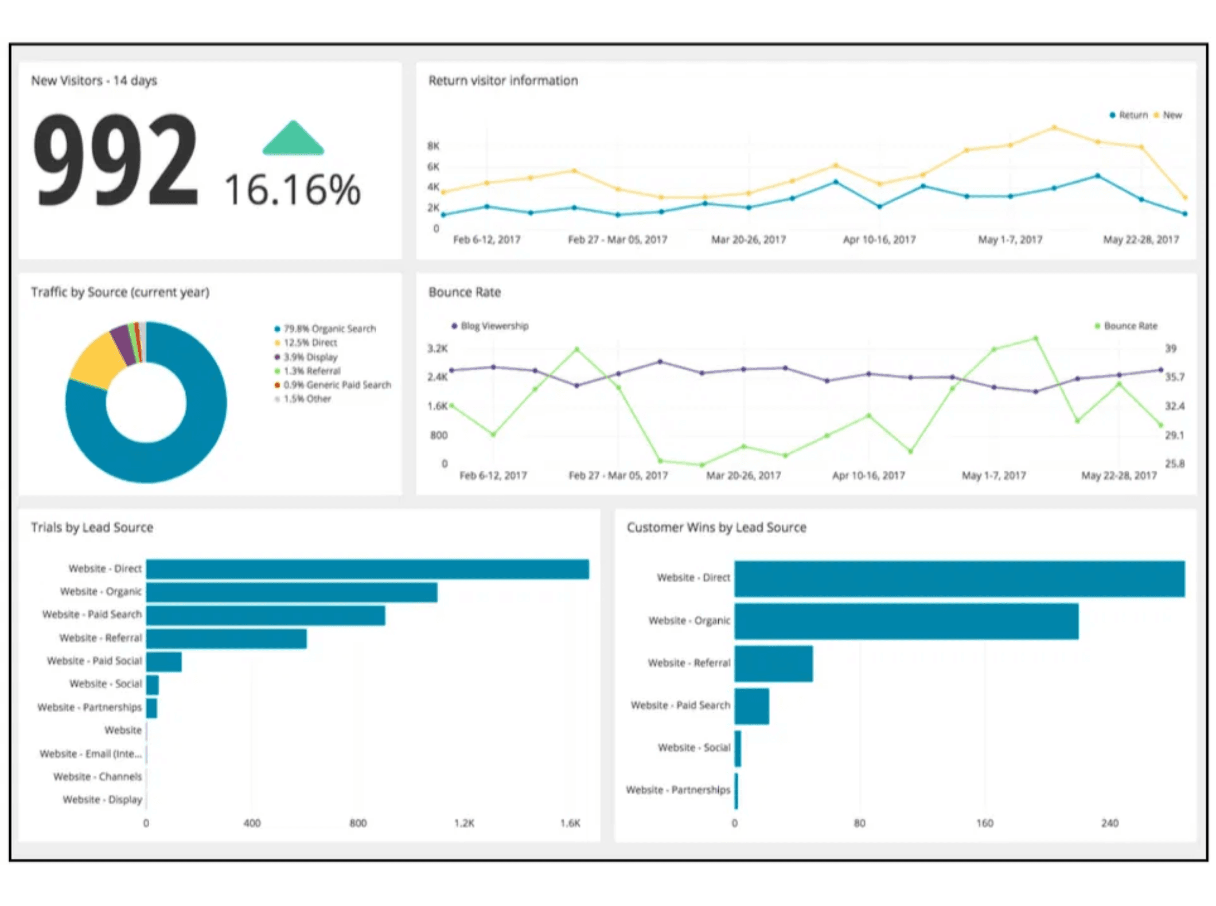
Your Journey Ahead
From Spreadsheets to Advanced Analytics
Excel
Advanced formulas, pivot tables, and visualization for business intelligence.
SQL
Querying databases to extract and manipulate large-scale datasets efficiently.
Python
Programming for automation, statistical analysis, and complex data processing.
AI & Machine Learning
Predictive analytics and intelligent decision support systems.
Your data-driven future begins now

